Slide 1

PSG COLLEGE OF TECHNOLOGY COIMBATORE - 641004 DEPARTMENT OF INFORMATION TECHNOLOGY
15I720 - PROJECT WORK 1
PROJECT TITLE : DIAGNOSIS OF DIABETIC RETINOPATHY USING CNNs
TEAM MEMBERS:
Meena R 17I318
Shiva G Ramakrishnan 17I342
Swathi B 17I350
Vinitha R 17I360
PROJECT GUIDE:
DR. S. K. SOMASUNDARAM

Slide 2
PROBLEM STATEMENT
Diabetic Retinopathy is a leading cause of blindness among working-age adults.
Early detection of this condition is critical for good prognosis.
Given an increase in prevalence of both diabetes and associated retinal complications throughout the world, manual methods of diagnosis maybe unable to keep apace with demand for screening service.
Hence, an automated solution is of utmost importance.

Slide 3
ARCHITECTURE OF THE SYSTEM
The proposed system for Diabetic Retinopathy detection has five phases namely,
dataset collection
pre-processing of retinal fundus images
feature extraction
feature selection
classification of level of severity

Slide 4
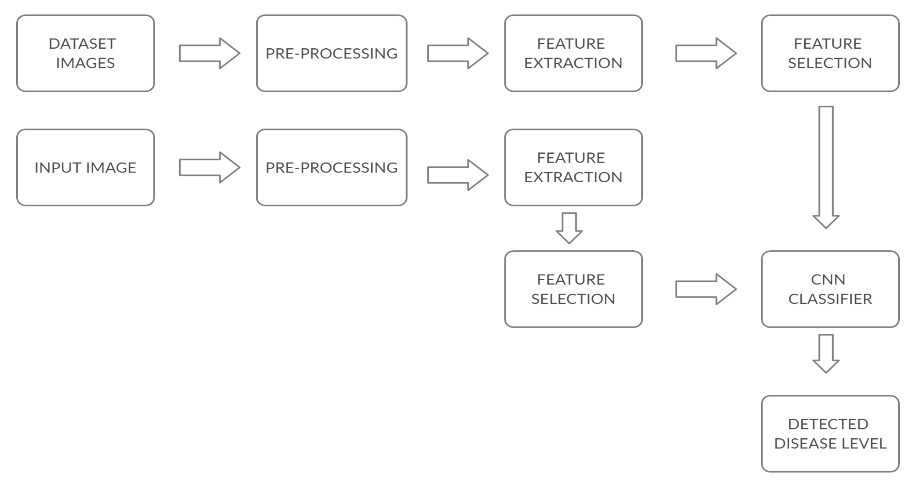
BLOCK DIAGRAM
Training phase
Testing phase

Slide 5
DATASET COLLECTION
The dataset has 35,126 retinal fundus images obtained from Kaggle’s diabetic-retinopathy-detection dataset.
It has a large set of high-resolution retina images taken under a variety of imaging conditions and different models of cameras.
A left and right field is provided for every subject. Images are labeled with a subject id as well as either left or right (e.g. 1_left.jpeg is the left eye of patient id 1).
A clinician has rated the presence of diabetic retinopathy in each image on a scale of 0 to 4, according to the following scale:
0 - No DR, 1 – Mild, 2 – Moderate, 3 – Severe, 4 - Proliferative DR
From the dataset, 80% of images are used for training and 20% for testing.

Slide 6
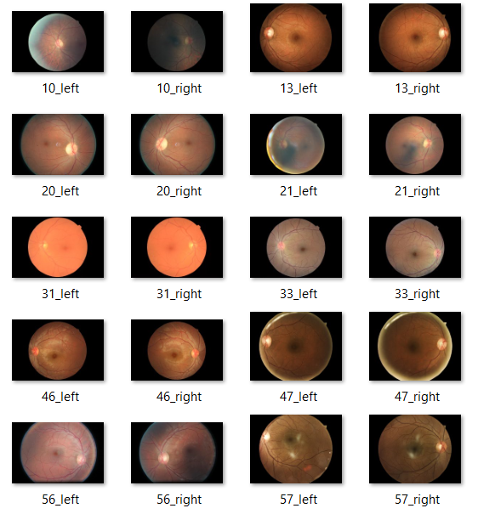
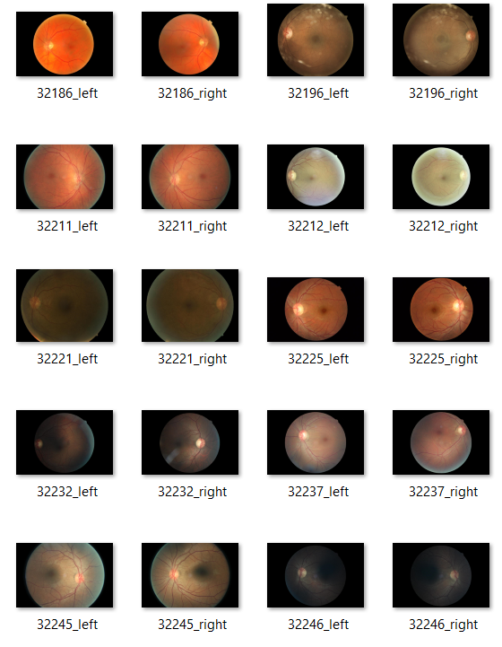
SAMPLE IMAGES FROM THE DATASET

Slide 7
SPLITTING THE DATASET
The downloaded Kaggle dataset has retinal images that are at different levels of severity and a csv file containing the file names and the respective level of severity (0,1,2,3,4).
The images need to be segregated according to the level of severity in order to train the classifier. Hence the dataset is further divided into 5 separate folders containing the images of only one particular level.
Once segregation is done, the dataset is split into train (80%) and test dataset (20%).

Slide 8
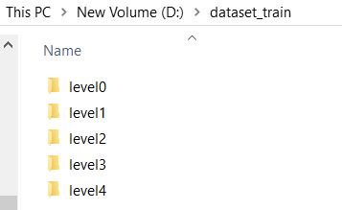
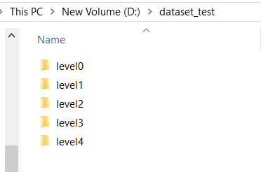
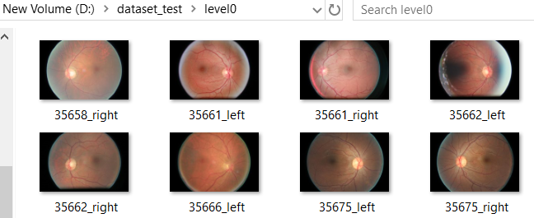
TRAIN AND TEST DATASET

Slide 9
PRE-PROCESSING
Pre-processing of the retinal images is required to ensure that the dataset is consistent and displays only relevant features.
The pre-processing techniques used are:
i) Resizing of the images
ii) Green channel extraction
iii) Contrast enhancement
i)Resizing- the dataset is highly imbalanced containing images of different resolution. This can increase the chances of overfitting. Hence we resize all the images to standard size of 256x256.

Slide 10
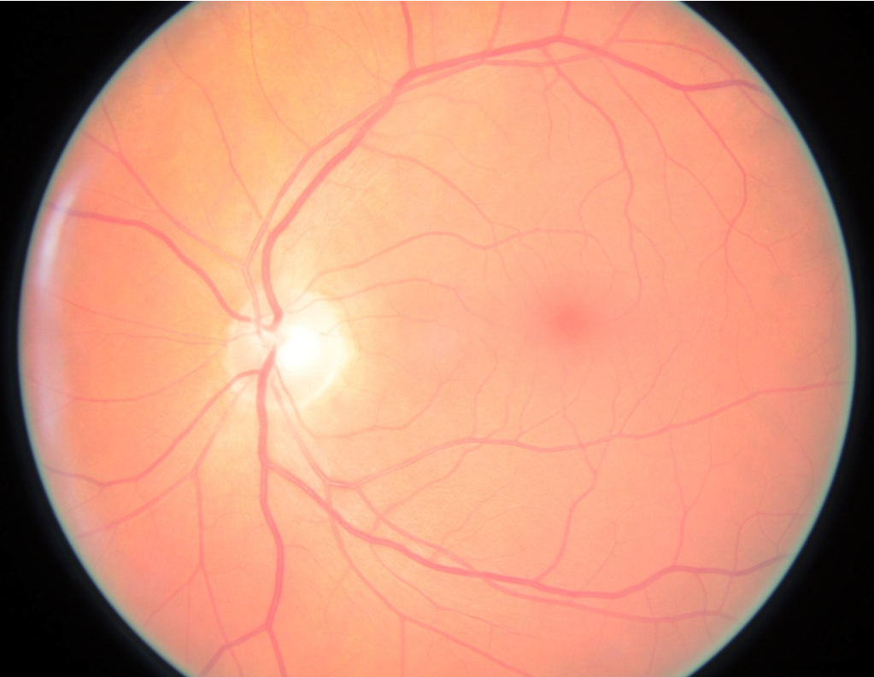
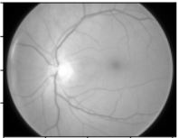
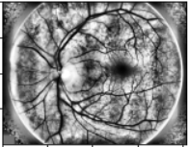
PRE-PROCESSING
ii)Green channel extraction – Of the three color channels in an image (Red, Green, Blue), the contrast between blood vessels, exudates and hemorrhages is best seen in the green channel and this channel is neither under-illuminated nor over-saturated like the other two.
iii)Contrast enhancement – To further enhance the features of the image, Contrast Limited Adaptive Histogram Equalization (CLAHE) is performed. The image is divided into smaller blocks and histogram equalization is done.
(a) Input retinal image (b) After green channel (c) After applying
extraction CLAHE

Slide 11
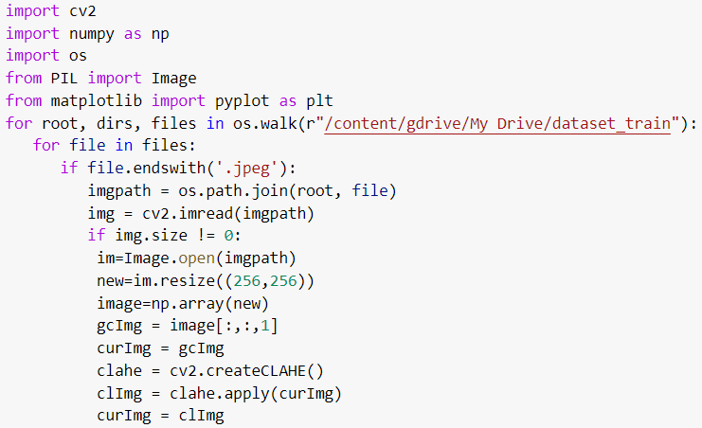
PREPROCESSING CODE

Slide 12
FEATURE EXTRACTION
Feature extraction is done by following three steps:
i)Dilation:
Dilation is the process of adding pixels to the boundaries of the objects in an image. The size and shape of the structuring element used to process the image defines the number of pixels to be added or removed from the object in an image.
To extract the exudates in the fundus images, the shape of the structuring element used for dilation is elliptical.

Slide 13
FEATURE EXTRACTION
ii)Thresholding:
To segment the exudates from the image, thresholding is used. A threshold pixel intensity is fixed. On inspecting each pixel of the image, if the pixel intensity is greater than the threshold value, white color is assigned else it is given black color.
The type of thresholding used is binary thresholding.

Slide 14
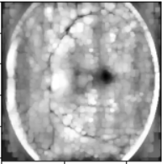
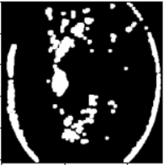
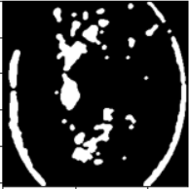
FEATURE EXTRACTION
iii) Noise Removal using Median Filter:
The median filter replaces a pixel intensity by the median of all the pixel intensities in the neighbourhood of a kernel.
It can filter out the outliers and helps in removal of salt and pepper noise generated.
(a)after dilation (b) after thresholding (c) applying median filter

Slide 15
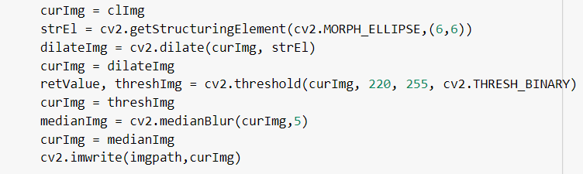
CODE FOR FEATURE EXTRACTION

Slide 16
FEATURE EXTRACTION
The features that can be extracted from the retinal images include Microaneurysms, Hemorrhages, soft and hard exudates, cotton wool spots and abnormal blood vessels.
Fuzzy C Means (FCM) clustering is one of the methods to extract these features.
FCM is a data clustering technique in which dataset is grouped into n number of clusters with every data point in the dataset belonging to every cluster to a certain degree.
It classifies pixels with various degrees of membership. Initial assumption for cluster centre is made, then FCM assigns a membership value for each data point. By updating the membership grade, the cluster centre gets updated.
Depending upon cluster size, FCM clustering is performed with the input data.

Slide 17


FCM clustering
Step 1: Initialize the data points into desired number of clusters randomly. Step 2: Find out the centroid.
The formula for finding out the centroid (V) is:
Where, µ is fuzzy membership value of the data point, m is the fuzziness parameter and xk is the data point.
Step 3: Find out the distance of each point from centroid.
Step 4: Updating membership values using the formula
Repeat the steps(2 to 4) until the constant values are obtained for the membership values

Slide 18
CLASSIFICATION
Convolutional Neural Network is used for the classification of severity level. The CNN is trained with images in the dataset and it determines the level of severity of DR for an input image.
A CNN convolves learned features with input data and uses 2D convolutional layers.
CNNs have an input layer, and output layer, and hidden layers.
The hidden layers usually consist of convolutional layers, ReLU layers, pooling layers, and fully connected layers.

Slide 19
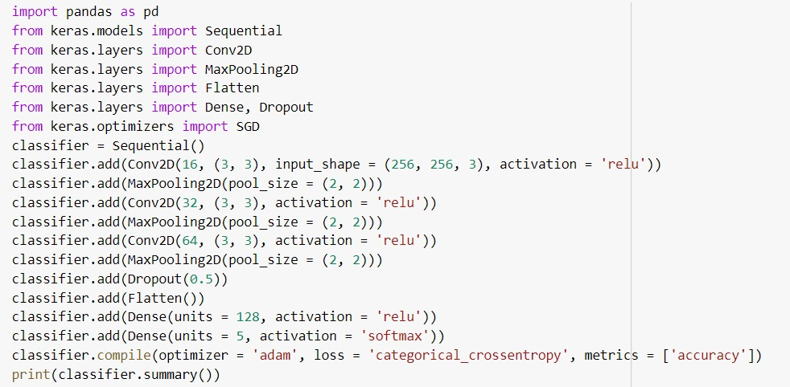
CODE FOR TRAINING THE CLASSIFIER

Slide 20
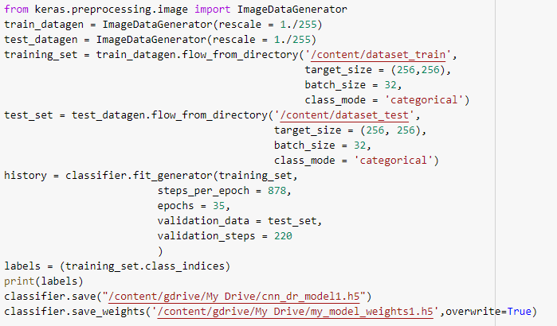
CODE FOR TRAINING THE CLASSIFIER

Slide 21
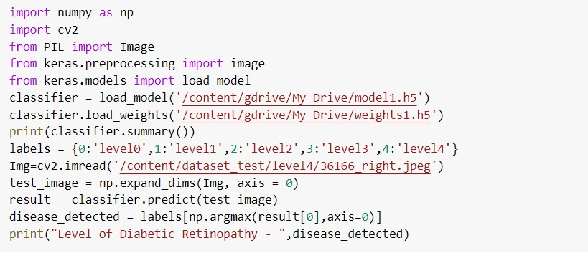
CODE FOR CLASSIFICATION

Slide 22
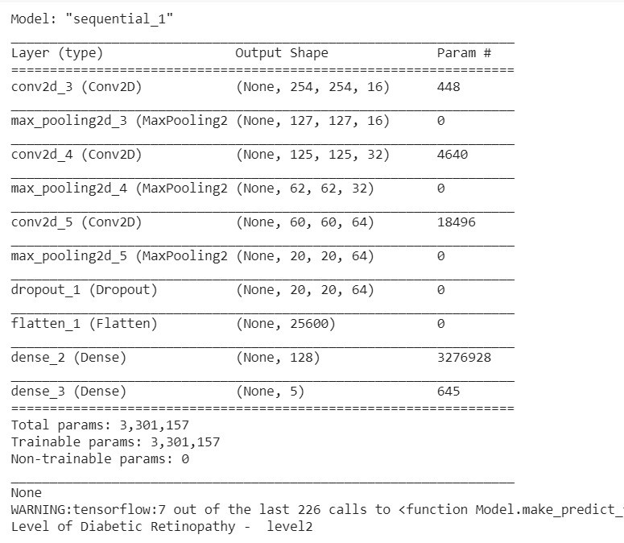
OUTPUT
The dataset images obtained from Kaggle contain 35,126 images. The images are resized to a of size 256 x 256 pixels.
80% of images (28,088) are used for training the convolution neural network model. The model was trained with batch size of 32 for 35 epochs. It resulted in training accuracy as 96% and testing accuracy as 91.2%

Slide 23
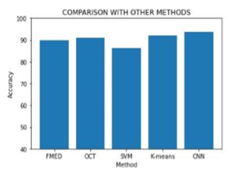
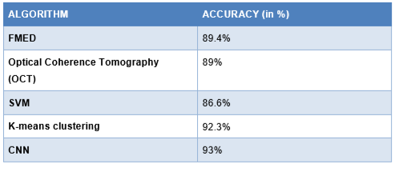
COMPARISON WITH OTHER METHODS

Slide 24
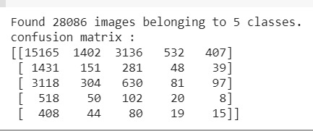
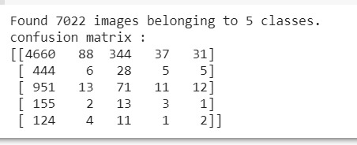
CONFUSION MATRIX
Confusion matrix helps to evaluate the model’s performance. As the name suggests it is a matrix of size n * n where n is the number of class labels.
Confusion matrix for Training dataset Confusion matrix for Testing dataset

Slide 25
FUTURE WORKS
Training the classifier with large number of retinal images can improve the accuracy of the system
Using clustering techniques for feature extraction and advanced CNNs like GoogleNet, AlexNet etc for classification can improve the efficiency of the system.
Increasing the number of hidden layers can help with increasing the performance of the system.
Adding User Interface can enhance the usability of the system.

Slide 26
MONTHS | SEPTEMBER |  |  |  | OCTOBER |  |  |  | NOVEMBER
ACTIVITIES / WEEKS | 1 | 2 | 3 | 4 | 1 | 2 | 3 | 4 | 1
PROJECT FINALIZATION & LITERATURE SURVEY
SYSTEM DESIGN
DATASET COLLECTION & MODEL BUILDING
IMPLEMENTATION OF PROTOTYPE AND TESTING
REPORT AND RESEARCH PAPER WORK
Work Planned
Work Done
Work in Progress

Slide 27
REFERENCES
1. Xu, Kele, et al. "SU‐F‐J‐04: Automated Detection of Diabetic Retinopathy Using Deep Convolutional Neural Networks." Medical Physics 43.6Part8 (2016): 3406-3406.
2. Varnousfaderani, Ehsan Shahrian, et al. "Diabetic retinopathy detection from image to classification using deep convolutional neural network." Investigative Ophthalmology & Visual Science 57.12 (2016): 5961-5961
3.Sun, Yunlei. "The Neural Network of One-Dimensional Convolution-An Example of the Diagnosis of Diabetic Retinopathy." IEEE Access 7 (2019): 69657-69666.
4. https://github.com/ebdulrasheed/Diabetic-Retinopathy-Feature-Extraction-using-Fundus-Images
5. Aleena, S. L., and C. A. Prajith. "Retinal Lesions Detection for Screening of Diabetic Retinopathy." 2020 11th International Conference on Computing, Communication and Networking Technologies (ICCCNT). IEEE, 2020.

